Slide 1
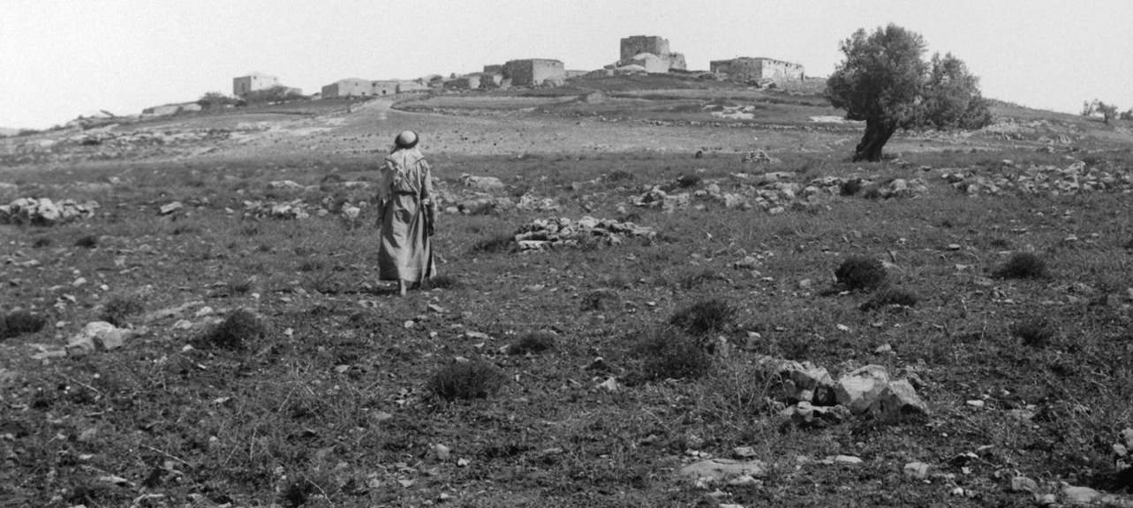
The Early Israelite Monarchy in Text and Archaeology
The Days of David and Solomon
Dr. Kyle Keimer
Macquarie University

Slide 2
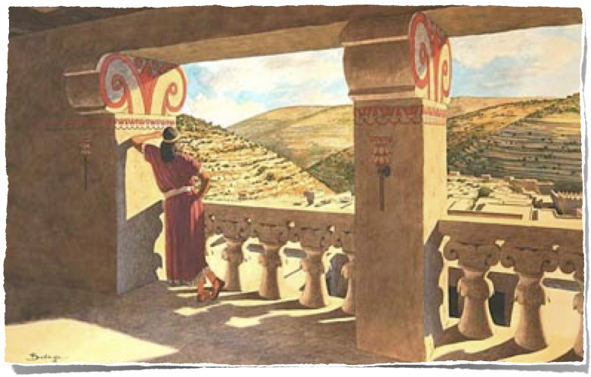
The Early Israelite Monarchy in Text and Archaeology
The Days of David and Solomon
Introduction
The United Monarchy in Text
The United Monarchy in Archaeology
Methodological Considerations
Integrating the Text and Archaeology: Jerusalem as a Case Study
Conclusions

Slide 3
The Early Israelite Monarchy in Text and Archaeology
The Days of David and Solomon
The United Monarchy in Text
1 Samuel 8 - 2 Samuel 24
1 Kings 1 - 1 Kings 12
1 Chronicles 10 - 2 Chronicles 9
Date of
Writing:
Historical
Date:
Authorship:
?
10-6th c BC?
Ca.1040-970 BC
?
10-6th c BC?
Ca.970-930 BC
?
4th c BC?
Ca.1040-930 BC

Slide 4
The Early Israelite Monarchy in Text and Archaeology
The United Monarchy in Text
1 Sam 8 A Call for a Monarchy
1 Sam 9 - 1 Sam 31 the Reign of Saul
2 Sam 1 - 1 Kgs 2:11 the Reign of David
1 Kgs 2:12 - 11:43 the Reign of Solomon
1 Kgs 12 Collapse of the United Monarchy

Slide 5
The Early Israelite Monarchy in Text and Archaeology
The United Monarchy in Text - the Reign of David
2 Samuel 1 – 1Kings 2:11
Conquers Jerusalem (1000 BC) [2 Sam. 5:6-10]
David builds palace in Jerusalem [5:11–12]
Hiram of Tyre supplies David with timber and craftsmen
Wars against the Philistines [5:17–25; 8:1]
Creates territorial state; defeats…
Moabites [8:2]
Arameans of Zobah led by Hadadezer [8:3f.]
Arameans of Damascus [8:5–8]
Hamath pays tribute [8:9f.]
Edomites [8:13f.]
Ammonites [10:1–14; 11:1]
Amalekites [8:12]
Attempted coup d’etat by Absalom [16:15–18:18]
More wars against Philistines [21:15–22]

Slide 6
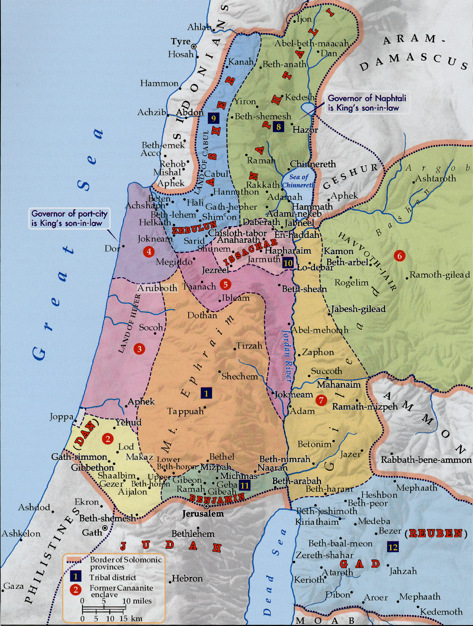
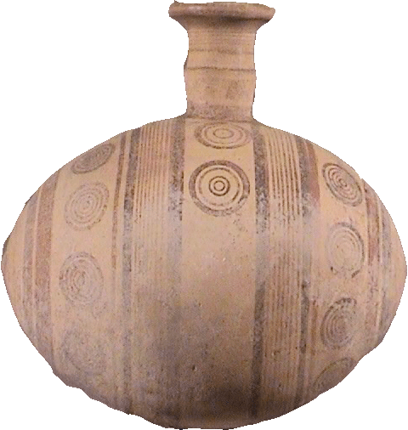
The Early Israelite Monarchy in Text and Archaeology
The United Monarchy in Text - the Reign of Solomon
I Kings 2:12–11:43
Marries pharaoh’s daughter (= treaty)
Receives Gezer as dowry of Pharaoh’s daughter
Administration and taxation
Establishes 12 administrative districts (minus Judah)
Taxes in kind; cf. lines of tribal divisions
Neighboring states pay tribute
Enters into trade and treaty relations with Hiram of Tyre
Cedar and craftsmen from Lebanon to Israel
Wheat, oil, and conscripted laborers from Israel to Lebanon
Maritime venture with Hiram of Tyre
Bestows 20 towns in Galilee to Hiram of Tyre
Builder:
Temple (967–960) and Palace (960–947) in Jerusalem
Builds and fortifies settlements
Acquires chariots, horses, and resources

Slide 7
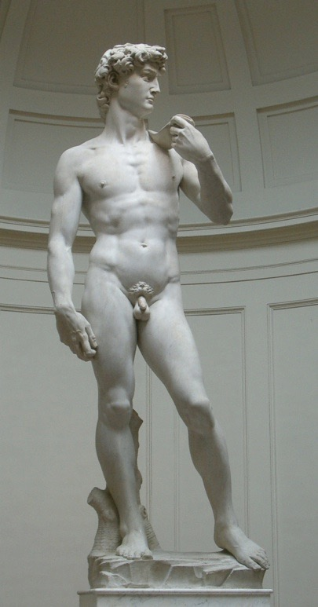
Textual Reasons for Disputes about the UM
Did I actually exist? If so, was I as great as everyone says?
Lack of chronological anchors in the biblical material
Debate over numbers: symbolic or literal?
Understanding of the semantic range of words for political and social structures
Uncertainty of the authorship and date of composition of the biblical texts
Uncertainty of the historicity of the biblical portrayal of the United Monarchy: Ideal vs. Real
Notes:
1.-2. Was the author(s) trying to make a nice literary portrait, or were they concerned with historical matters?
3. Modern equivalents are not the same as ancient terms
4. Later editing and propagandistic matters.
5. Only 1 clear reference to David outside the Bible (possible a second)
None to Solomon

Slide 8
The Early Israelite Monarchy in Text and Archaeology
The Days of David and Solomon
The United Monarchy in Archaeology
Bible and Archaeology
Low Chronology
Modified Conventional Chronology
Iron Age I
Iron Age IIA
1200-1000 BC
1000-925 BC
ca. 1130-930
ca. 930-830/800
ca. 1180-980
ca. 980-830

Slide 9
The Early Israelite Monarchy in Text and Archaeology
The Days of David and Solomon
The United Monarchy in Archaeology
Traditional : 1000-925 BC
Aharoni and Amiran : 1000-840 BC
NEAEHL : 1000-900 BC
Barkay : 1000-800 BC
Modified Conventional Chronology : ca. 980 - ca. 840/30 BC
Low Chronology : ca. 925-905 - 845/800 BC
Herzog and Singer-Avitz (2004 & 2006) : Early Iron IIa (950-900/880
BC) and Late Iron IIa (900/880-800 BC)
Based on Biblical Text: Period of the United Monarchy
End date based on changes in ceramic forms, particularly cooking pots
Compromised date based on various views of ceramic changes
Based on changes in the material culture, particularly ceramics
Based on changes in the material culture, particularly ceramics*
Based on ambiguous ancient sources and comparison of relative strata*
Based on changes in the ceramics

Slide 10
Archaeological Reasons for Disputes about the UM
Did I actually exist? If so, was I as great as everyone says?
Lack of chronological anchors in the archaeological material
Debate over which historical events created chronological anchors in the archaeological material
Understanding of political and social structures (including the nature of both the governing authority and how power is rationalized)
Gradual and regional change in ceramics
Uncertainty of correlating specific structures to specific biblical kings
Flattened Radiocarbon curve

Slide 11
The Early Israelite Monarchy in Text and Archaeology
The Days of David and Solomon
Methodological Considerations
Modern Interpretive Bias (with Texts and Archaeology)
Understanding Ancient Socio-Political Structures
Understanding Ancient Economies
Understanding Spatial Realities
Evolutionary/Linear/Functionalist/etc.
Bureaucratic vs. Patrimonial
One Economy or Many? Capitalist or not?
Territoriality and Borders
Notes:
Ancient Socio-Political Structures
Centralized states vs. Patrimonial or hierarchical/decentralized states
Ancient Economies
What was the ancient economy?
Modernists: ancient E did not differ greatly from modern E
Primitivsts: small-scale, agrarian, stagnant in comparison to modern capitalism
Formalist: ancient E differ only in degree from modern capitalist Es
Substantivist: non-capitalist Es are fundamentally different from modern capitalist Es
Redistributive, royal, local, tributary?
Schloen 2016:443 self-sufficient agrarian householding, local kin-based reciprocity, and governmental redistribution with some market exchange in certain contexts
Spatial Realities
a. Territoriality–“the social construction of spaces by political processes that act as platforms for the expression of power” (Flint 2005:6).
“War, whether interstate or guerrilla, is a political process that has as its purpose the control of territory to enable subsequent projections of power”
b. Borders–the geographic features that demarcate the key political institution, the kingdom
*These two do not equal each other, yet many scholars conflate them. They were separate in antiquity as well (cf. specific use of words in Heb. Bible)

Slide 12
The Early Israelite Monarchy in Text and Archaeology
The Days of David and Solomon - Methodological Considerations
Understanding Ancient Socio-Political Structures
Evolutionary Approach
Band
Tribe
Chiefdom
State
“Primitive”
“Civilized”
Multilineal Approach
Key considerations: rationalization, environment, religion, ideology
Band
Tribe
Chiefdom
State

Slide 13
The Early Israelite Monarchy in Text and Archaeology
The Days of David and Solomon - Methodological Considerations
Understanding Ancient Socio-Political Structures
Rationalization of Power (according to Weber)
Charismatic: “resting on devotion to the exceptional sanctity, heroism or exemplary character of an individual person, and of the normative patterns or order revealed or ordained by him.”
Traditional: “resting on an established belief in the sanctity of immemorial traditions and the legitimacy of those exercising authority under them.”
Legal-Rational: “resting on an established belief in the legality of enacted rules and the right of those elevated to authority under such rules to issue commands.”
The United Israelite Monarchy is characterized by Charismatic and Traditional rationalizations of power
How is this reflected in the archaeology?

Slide 14
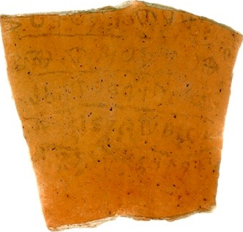
The Early Israelite Monarchy in Text and Archaeology
The Days of David and Solomon - Methodological Considerations
Understanding Ancient Socio-Political Structures
Rationalization of power is NOT a guaranteed indicator of social structure, and vice versa
Tribal societies can have monarchs.
States can be tribal in nature
The key is the nested concept of society

Slide 15
The Early Israelite Monarchy in Text and Archaeology
The Days of David and Solomon - Methodological Considerations
Understanding Ancient Socio-Political Structures
Heb. beney Israel
Israel (= Nation)
Heb. shebet/mateah
Issachar
(= Tribe)
Naphtali
Asher
Zebulun
Ephraim
Manasseh
Benjamin
Dan
Judah
Simeon
Reuben
Gad
Levi
Heb. mishpacha
Clan
Clan
Clan
Clan
Clan
Heb. bet ’ab
Household
Household
Household
Household
Household
See, for example, Numbers 1 and 26

Slide 16
The Early Israelite Monarchy in Text and Archaeology
The Days of David and Solomon - Methodological Considerations
Understanding Ancient Socio-Political Structures
Heb. bet ’ab (House of the Father)
Father
Patrimonialism is Common Throughout the ANE from at least the 3rd Millennium BC
God
Wife
King
Son 1
Son 2
King
Israelites
Grandson
Grandson
Servants
Son 1
Son 1
Official 1
Non-Israelites
Son 1
Son 2
Son 1
O1
O2
Later
(Patrimonial
Bureaucracy)
Earlier

Slide 17
The Early Israelite Monarchy in Text and Archaeology
The Days of David and Solomon - Methodological Considerations
Understanding Ancient Socio-Political Structures
What was the nature of the Early Israelite Monarchy?
Bureaucratic
Patrimonial
Writing is Necessary
Public vs. Private
Socio-Political Complexity = Complex Material Culture
Authority is Legal-Rational
Centralized Authority
Writing is Optional
No Concept of the Private
Socio-Political Complexity may/may not = Complex Material Culture
Authority is Charismatic/Traditional
De-centralized or Tiered Authority

Slide 18
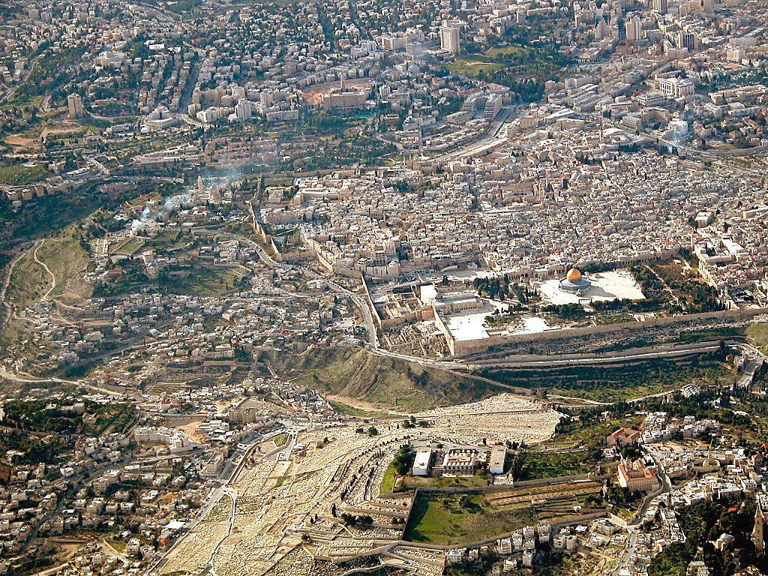
The Early Israelite Monarchy in Text and Archaeology
The Days of David and Solomon
Integrating the Text and Archaeology: Jerusalem as a Case Study

Slide 19
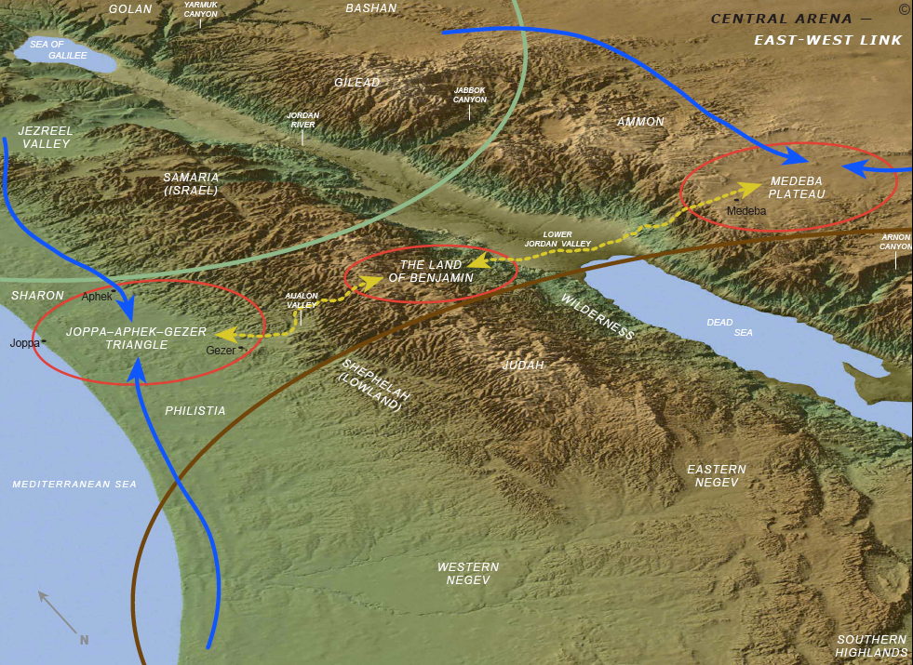
Jerusalem
Hebron
The Political Advantages of Jerusalem
Central location
How to unite tribes under one capital?
Neutral location
How to rally tribes around a capital with no previous nationalistic sentiments?
Closer to Benjamin
How to protect main route to the central hills?

Slide 20
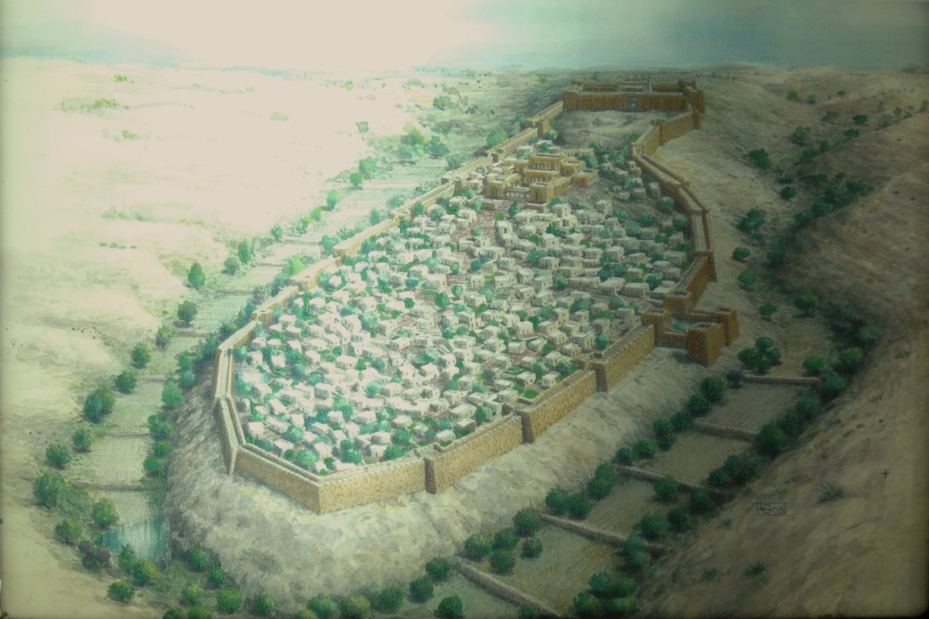
David’s Conquest of Jerusalem
Temple
(ca. 1000 BC)
Fortress
of Zion?
Ophel
“Millo”
Western Hill
Gihon
Spring
“Warren’s
Shaft”
City of David
Siloam Channel
Siloam
Pool
– 2 Sam 5-6 Conquest of Jebus
– What is the “tzinnor”?
– Renames Jebus the “City of David”

Slide 21


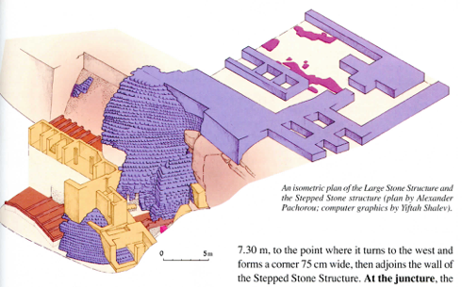
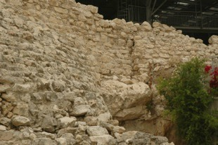
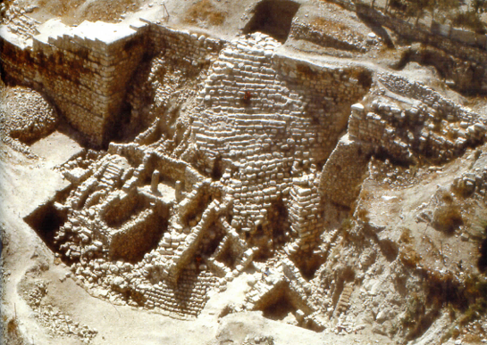
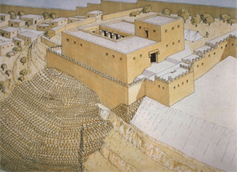
11th-10th Century Jerusalem
Was Jerusalem
a major city?
What is required
for a capital?

Slide 22
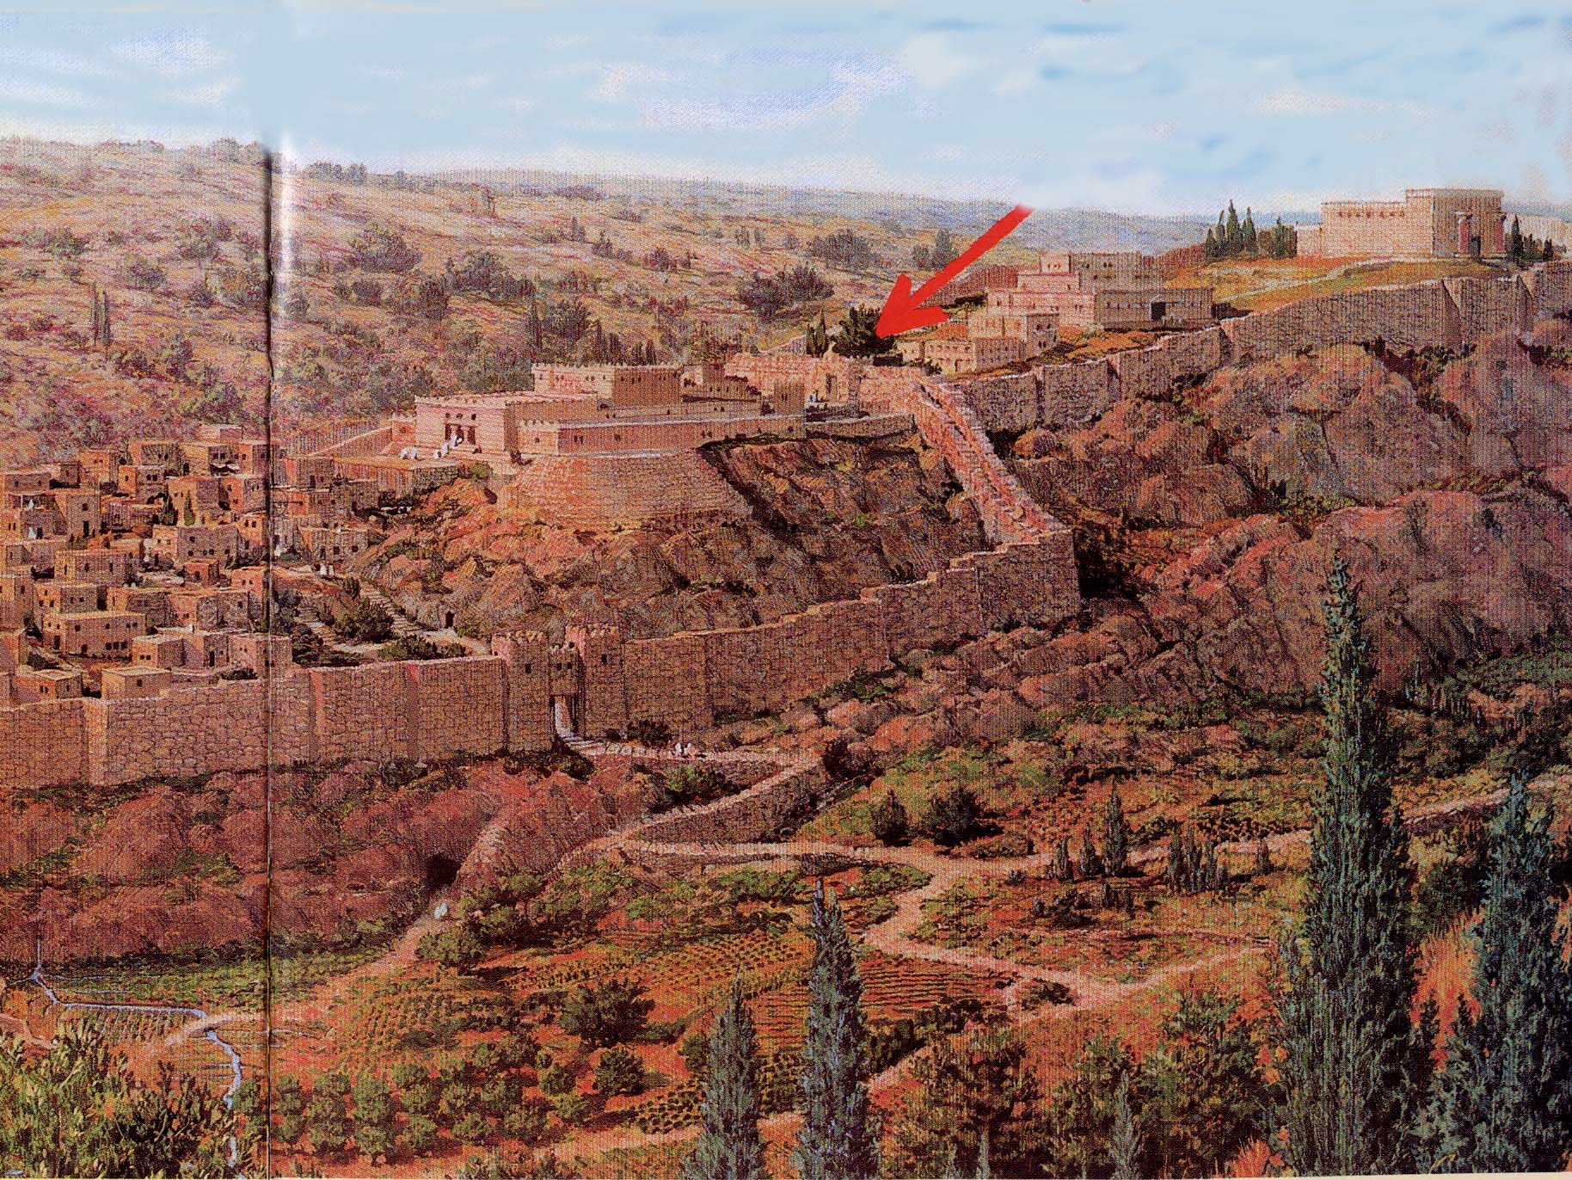
Solomon’s Palace
Solomon’s
Temple
Ophel
Gate
Temple
Mount
Ophel
Solomon’s
Palace
David’s
Palace
Above
the “Millo”
Palace of the Forest of Lebanon (1 Kings 7:1–12)
13 years to build
Multiple buildings with residence and “Hall of Justice”
Phoenician craftsmen
Cedar beams
Immense masonry

Slide 23
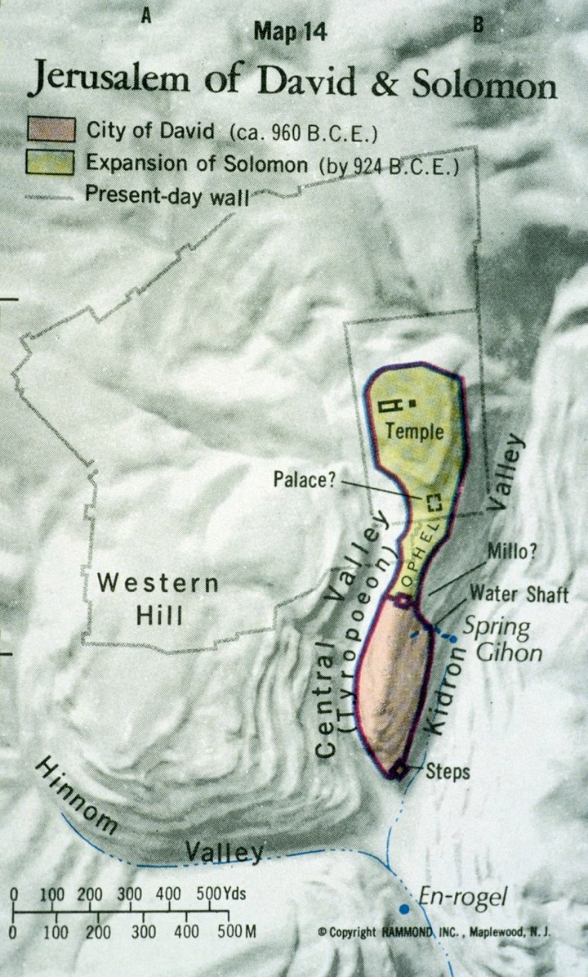
Temple Mount and City of David aerial from east
Notes:
The City of David
The earliest inhabitation of Jerusalem was on the Eastern Hill. In many ways this seems illogical, and in fact, Byzantine pilgrims mistakenly located the oldest part of the city on the Western Hill.
The Western Hill is superior to the Eastern Hill because it is larger, flatter, higher and easier to build upon.
The Eastern Hill was the site of the earliest settlement because of the Gihon Spring, the only water source in the area.

Slide 24
Temple Mount and City of David aerial from east
Notes:
The City of David
The earliest inhabitation of Jerusalem was on the Eastern Hill. In many ways this seems illogical, and in fact, Byzantine pilgrims mistakenly located the oldest part of the city on the Western Hill.
The Western Hill is superior to the Eastern Hill because it is larger, flatter, higher and easier to build upon.
The Eastern Hill was the site of the earliest settlement because of the Gihon Spring, the only water source in the area.

Slide 25
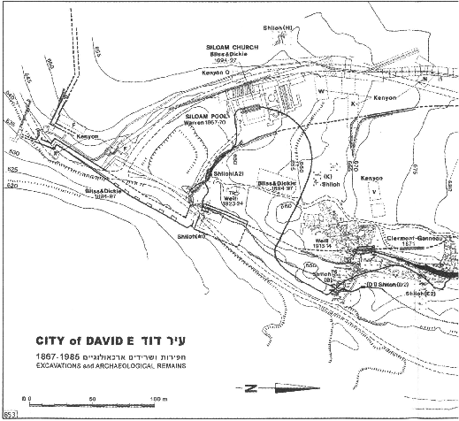
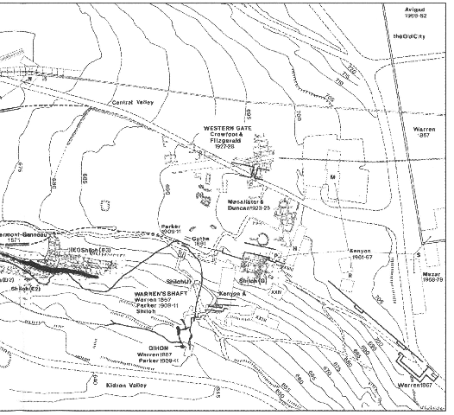
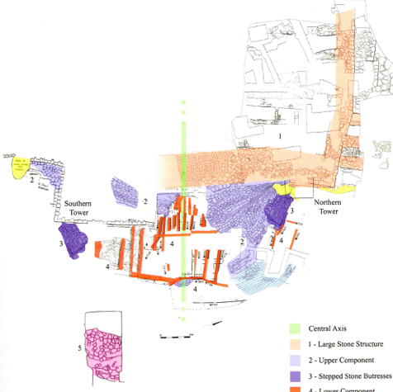
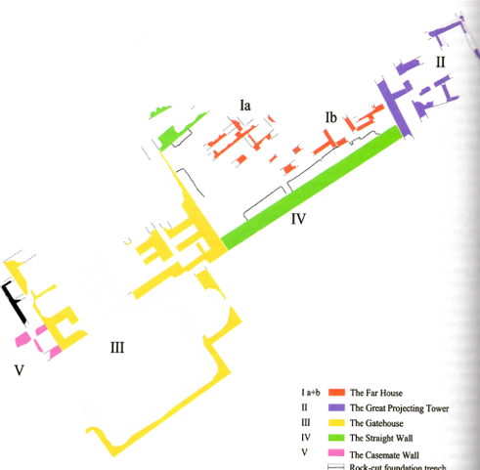
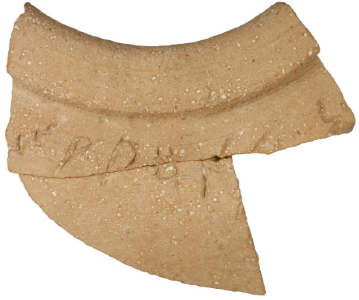
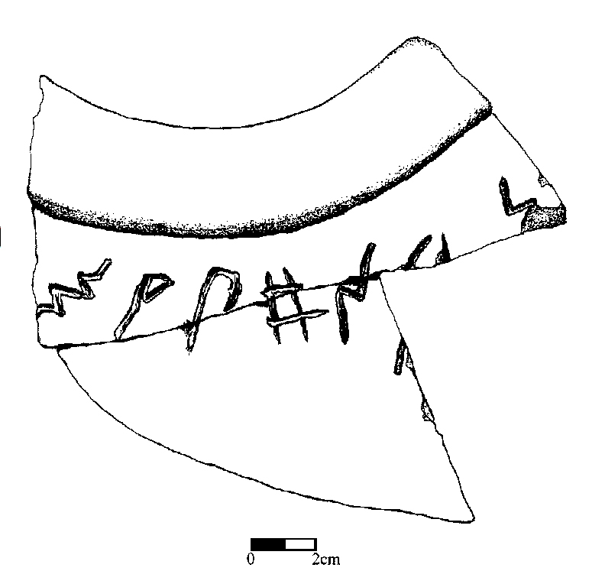
Jerusalem Pithos Inscription

Slide 26
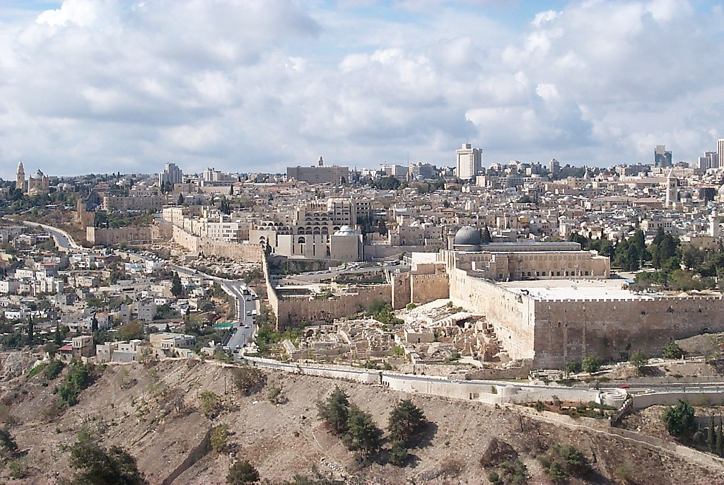
N
Southern Temple Mount/Ophel excavations from east
Notes:
Southern Wall: Hulda Gates
The gates on the southern wall of the Temple Mount were known as the Hulda Gates. Two explanations are given for this name. The gates may have been named after the prophetess Hulda (2 Kings 22), or the word hulda, which means “mole,” may reflect the underground nature of these passageways.
The western gate, known as the “Double Gate,” has two doorways. The eastern gate, or“Triple Gate,” has 3 arches marking the entrance, although some scholars believe that this was a double gate in antiquity.
Both gates are blocked today.

Slide 27
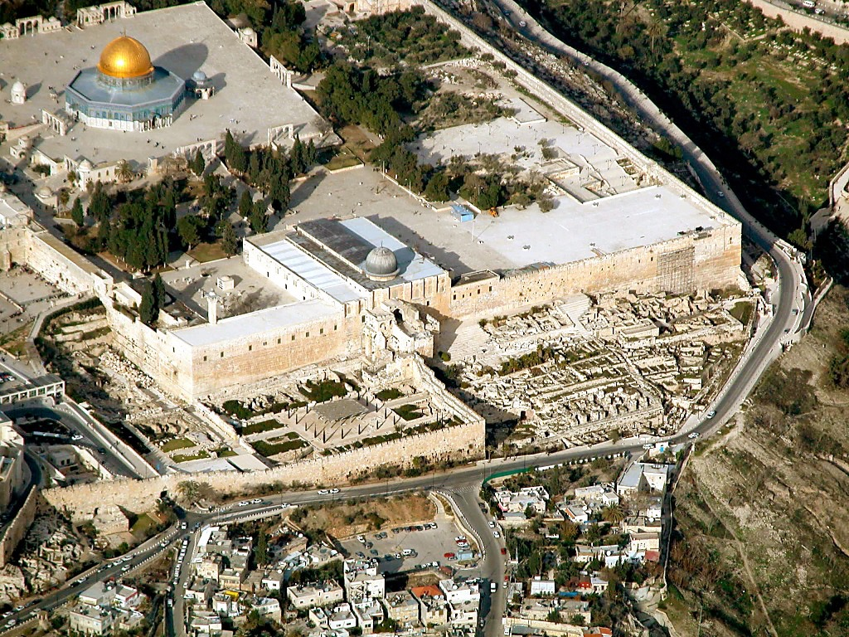
N
Southern Temple Mount/Ophel Excavations aerial from southwest
Notes:
Excavations
Excavations of the area south of the Temple Mount began in February 1968, immediately after the capture of the Old City by Israel. They continued until 1978.
The excavations were sponsored by the Israel Exploration Society and Hebrew University of Jerusalem.
The director was Benjamin Mazar, and his assistant was Meir Ben-Dov.
The excavation was opposed by Jewish rabbis and Muslim religious authorities.
The Ministry of Labor provided 150 workers.
Volunteers came for periods of one week at time.
In total, 300,000 cubic meters (10.5 million cu ft.) of earth were moved.

Slide 28
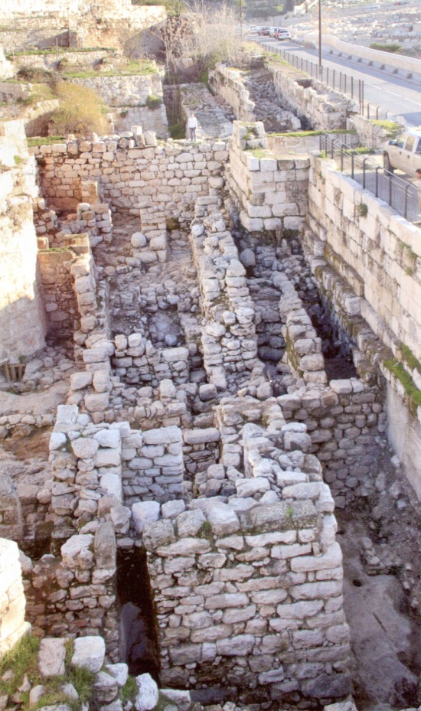
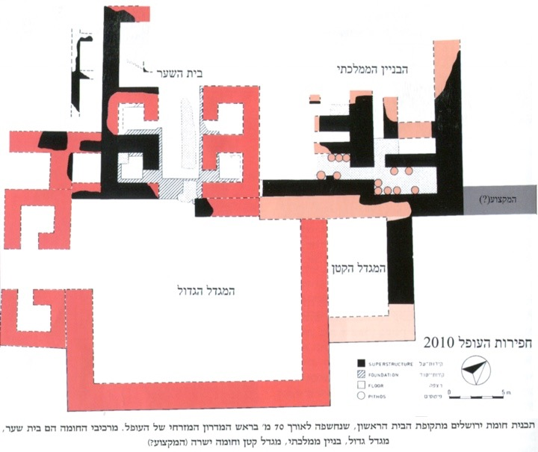
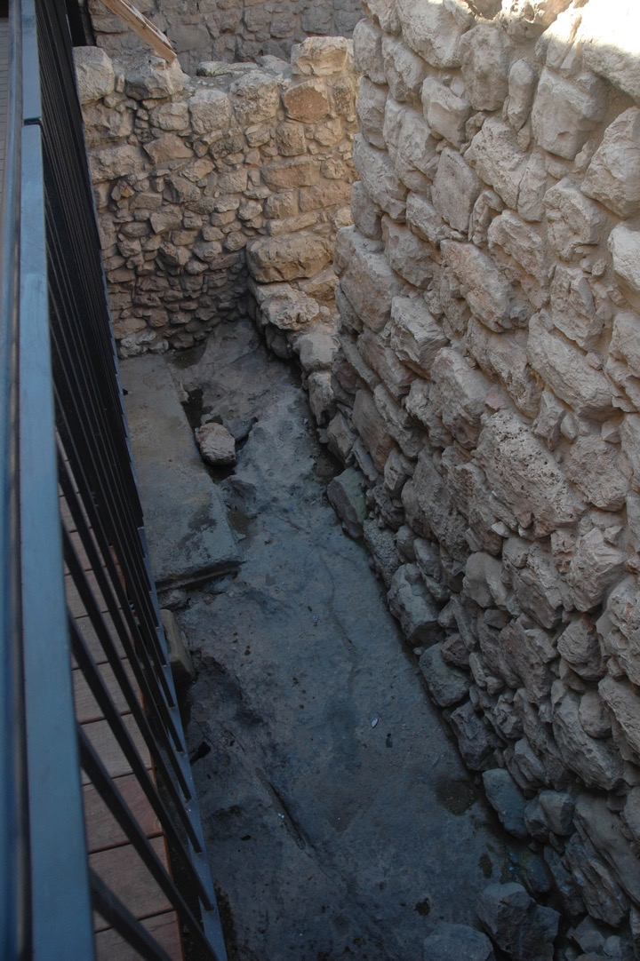
Solomon built...the house of the LORD and his own house, the Millo and the wall of Jerusalem
1 Kgs 9:15

Slide 29
The Early Israelite Monarchy in Text and Archaeology
The Days of David and Solomon
Conclusions
Use an appropriate theory for understanding the ancient Near East and ancient Israel in particular. Understand the context.
Match our expectations to our theory
A reading of the biblical texts must be attuned to a given text’s genre, our hermeneutics, and the available comparative ancient literature
Interpretation of the archaeological remains requires a theoretically informed hermeneutic so the best model of ancient society can be allowed to speak for itself (as much as possible)
When points 1-4 are considered, many disparities noted by biblical scholars and archaeologists become resolvable
When points 1-4 are considered, a literarily viable, historically reliable, and archaeologically verifiable portrait of the United Monarchy is possible.

